Slide 1
CS 6330 Final Project
User Identification based on Gait
Dan Olson
Rich Lukas
Robert Burkhardt

Slide 2
CS 6330 Final Project
Problem Statement
The Goal of this project was to collect time series data from an IMU, and use it to identify individuals and activities
Gait is the cyclic movement of the body during locomotion
Gait can be broken down into the Stance phase and Swing phase
Stance Phase Stance Phase
Heel Strike Acceleration Phase
Foot Loading Mid-Swing
Midstance shift Deceleration Phase
Heel-off
Toe-off
Movement is highly individualized and unique to each person
Typical tools consist of stop motion photography, pressure sensors, and accelerometers strapped to the body.

Slide 3
CS 6330 Final Project
Methodology
Data Collection
Three test subjects were outfitted with a 6 axis IMU, which recorded angular velocity and acceleration
Data was collected at 500 hz and then down sampled to 100 hz
The sensor was mounted at the hip
The recorded activities included
Walking at a measured pace
Running
Stair climbing/descending
Treadmill
Sitting
Jumping
Standing

Slide 4
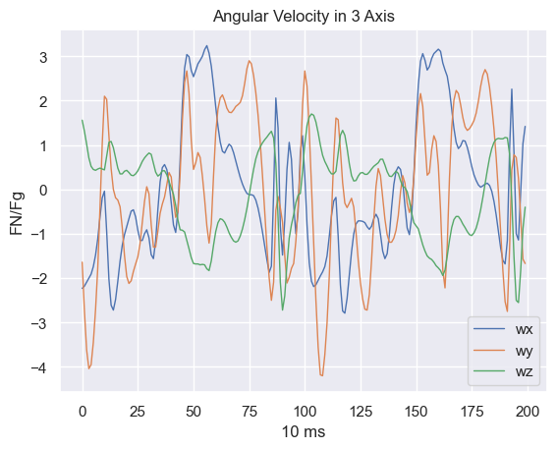
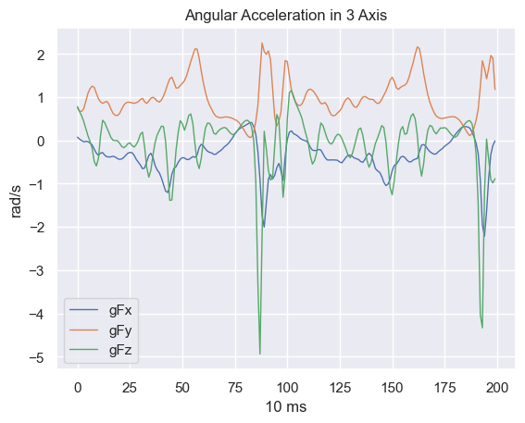
CS 6330 Final Project
Visualization
Visualization of IMU Data Walking at 1 step per second

Slide 5
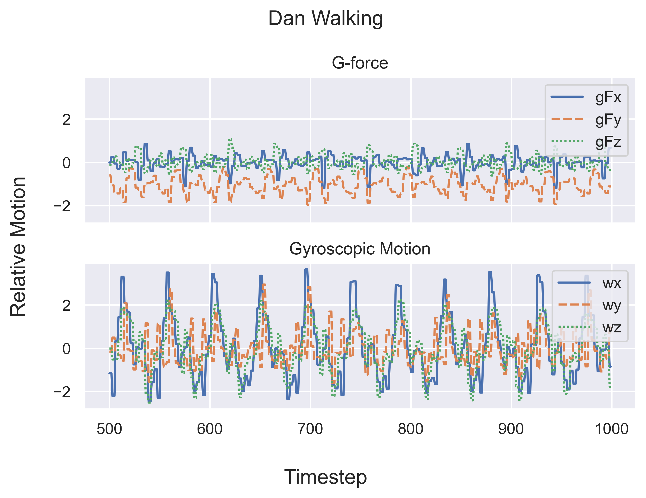
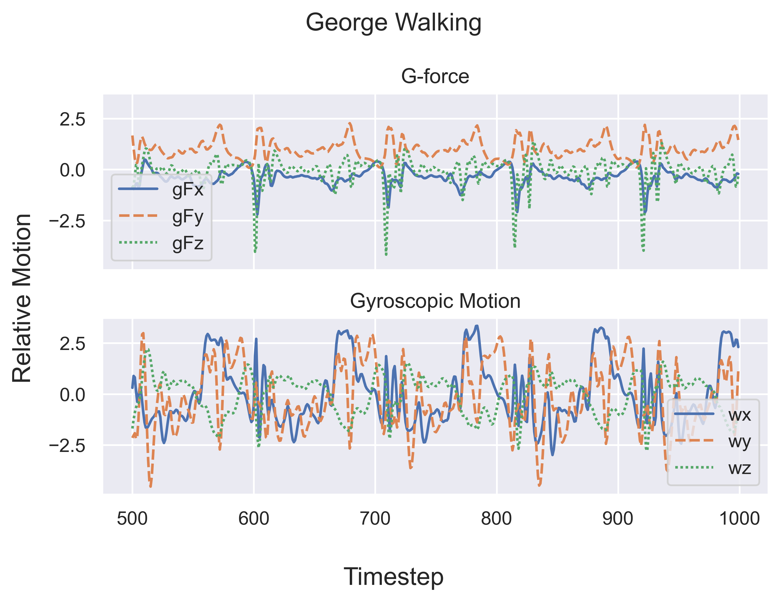
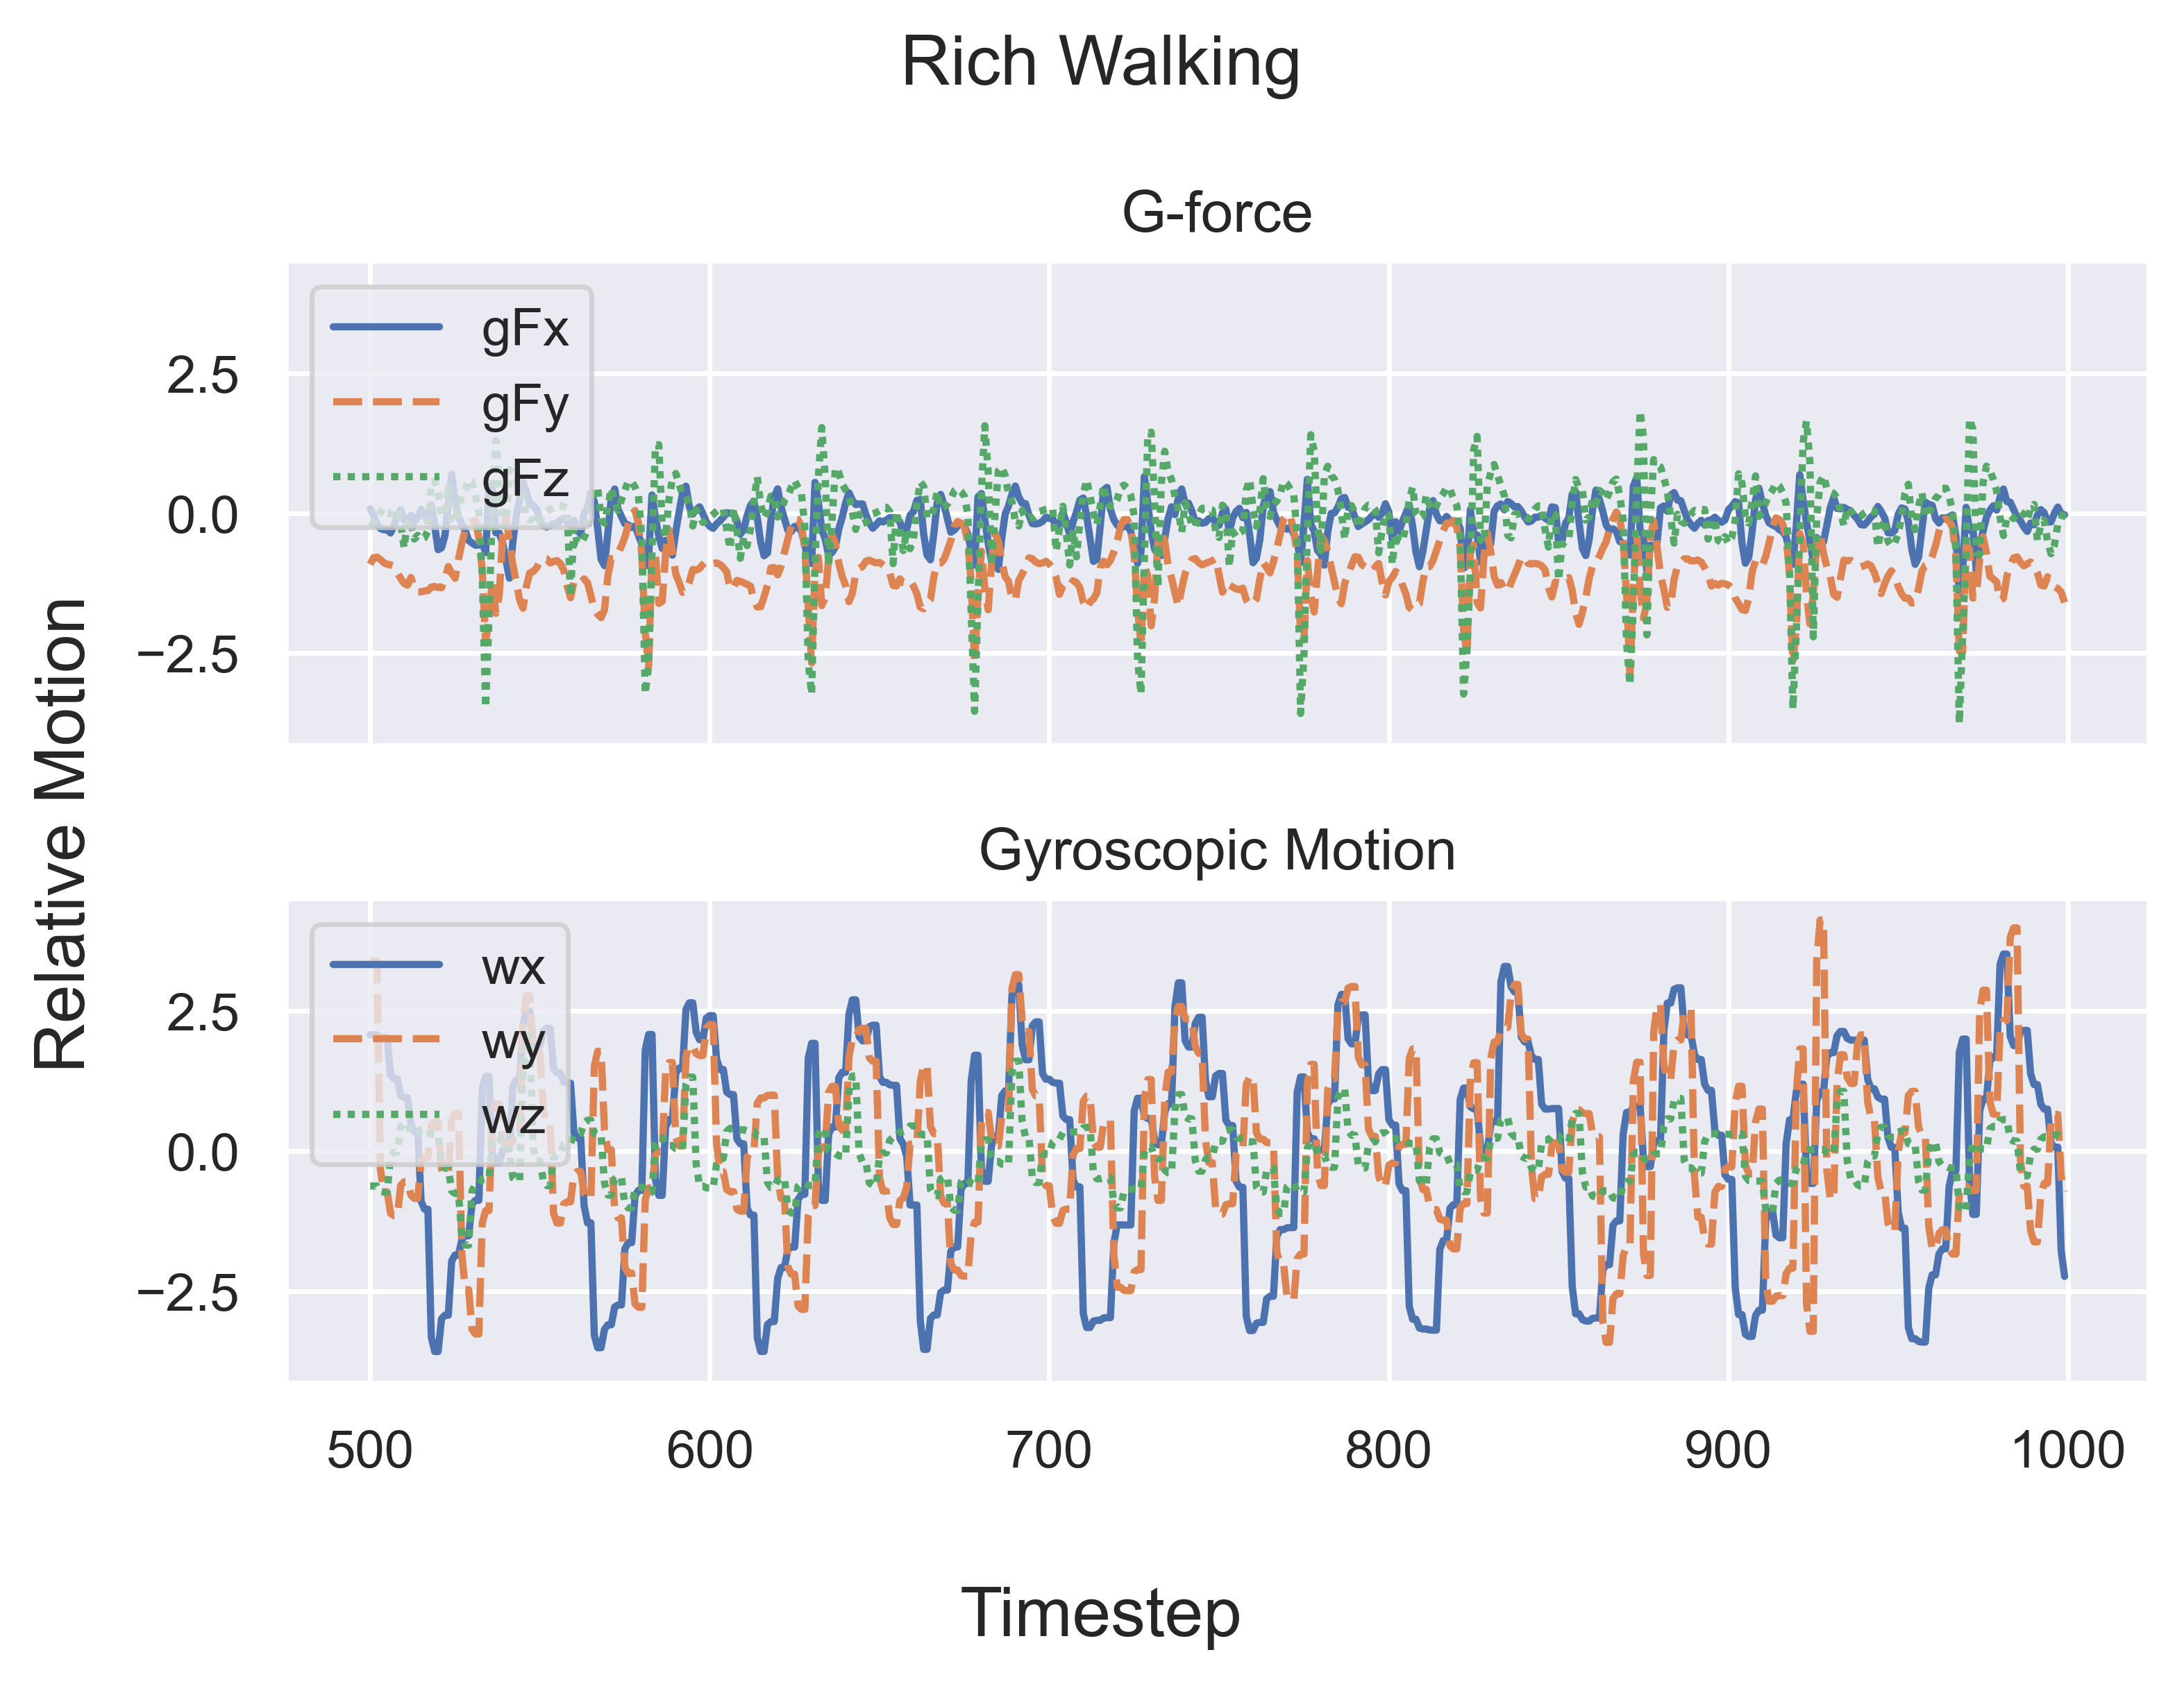
Uniqueness of Gait
Visualization

Slide 6
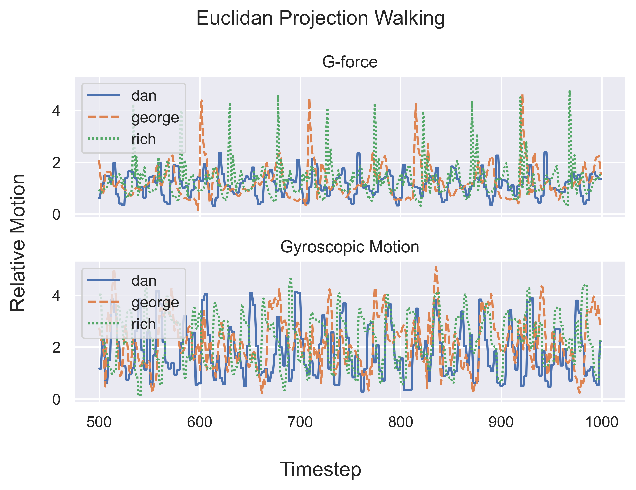
Uniqueness of Gait
Visualization

Slide 7
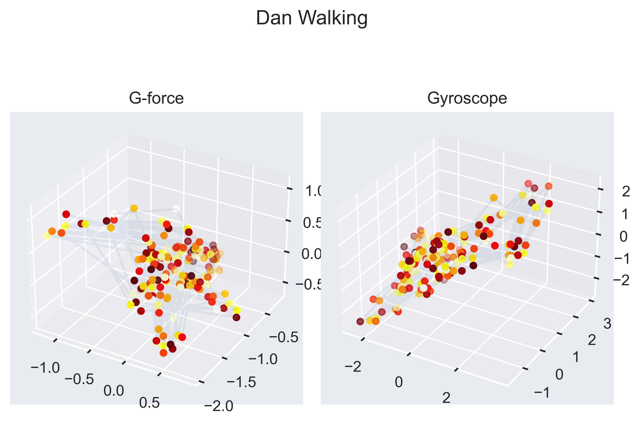
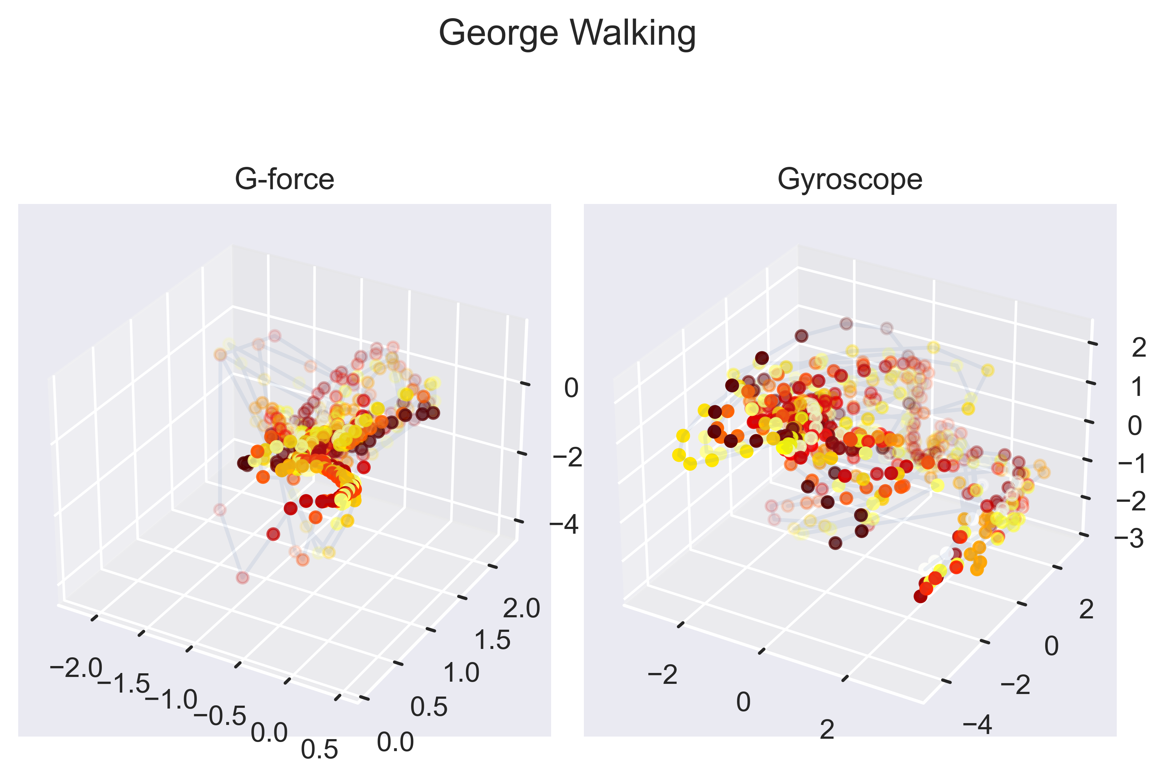
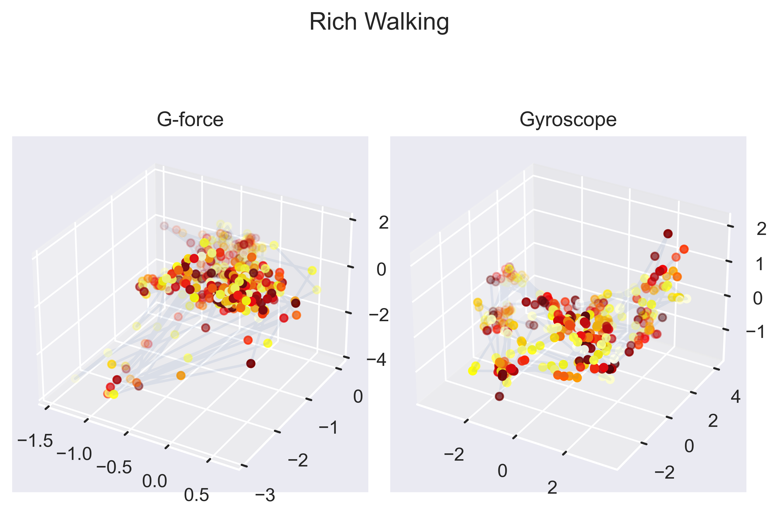
Forces in 3-space
Visualization

Slide 8
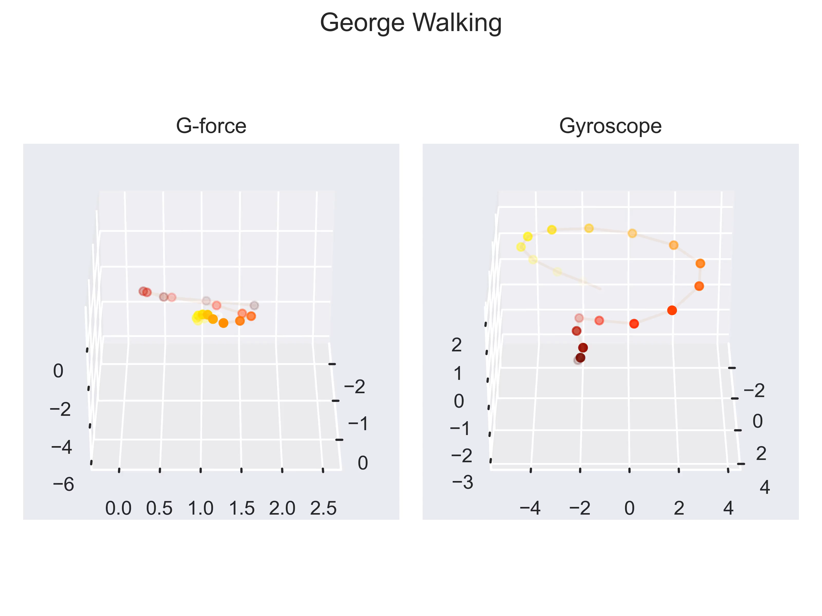
Forces in 3-space
Visualization

Slide 9
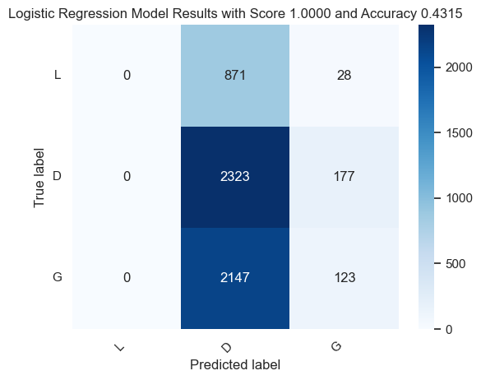
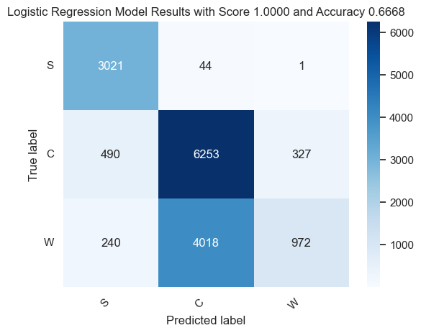
Forces in 3-space
Identify Individuals
Our initial model was a Logistic Regression Classifier.
Angular Velocity Only
Angular Acceleration Only

Slide 10
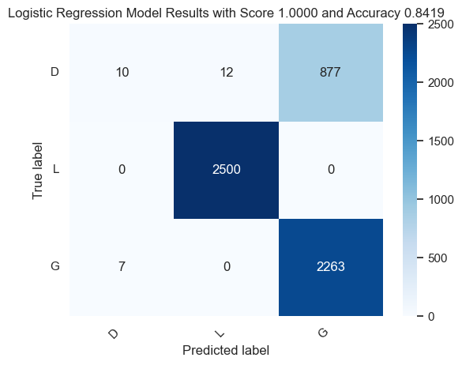
Forces in 3-space
Identify Individuals
We built a model using both angular velocity and acceleration, and applied
a low pass filter to smooth the data

Slide 11
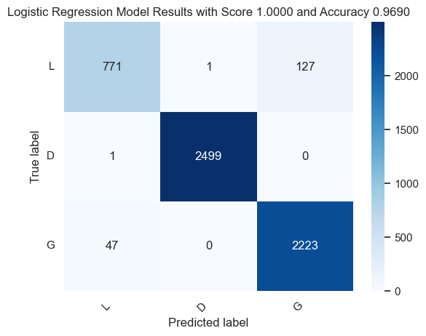
Forces in 3-space
Identify Individuals
After looking at the outliers, we added an addition EWMA filter with a half
Life of 100 ms to add more trend data to the model

Slide 12
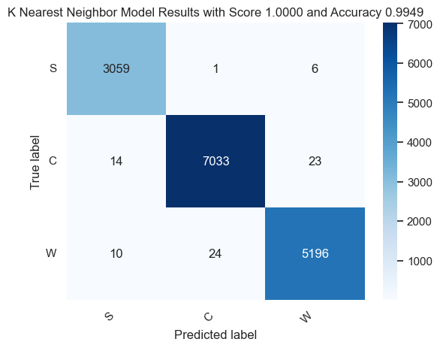
Forces in 3-space
Best Model for Activity Identification
Multiple Classifier models were developed, including
Logistic Regression Support Vector Machine
Random Forest Decision Tree
K Nearest Neighbors Multi-layer Perceptron Classifier
The KNN model once again did quite well, outperforming all other models. All models were built on stratified Train Test data and compared using a separate Validation dataset.

Slide 13
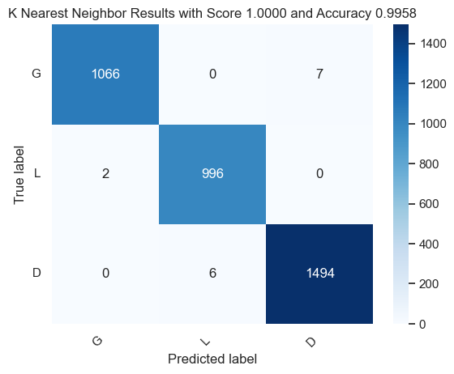
Forces in 3-space
Best Model Results User Identification
Six Different Classifier Models were evaluated, to identify a unique individual. Overall, the best classifier in repeated testing was a model based on K Nearest Neighbors.

Slide 14
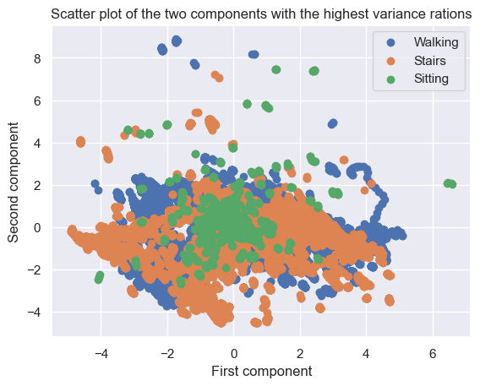
Forces in 3-space
Identify Activity
Time series data on a variety of activities was collected and labeled. The same feature set as before was used to build classifier models.
To help visualize the data a partial correlation analysis was taken to reduce the feature set.
Visually it can be seen
that the data clusters
are heavily overlapped.

Slide 15
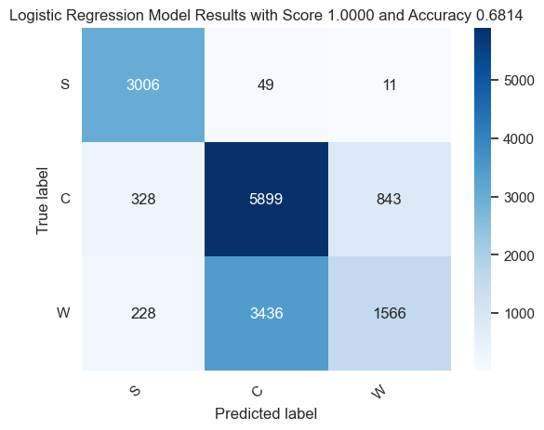
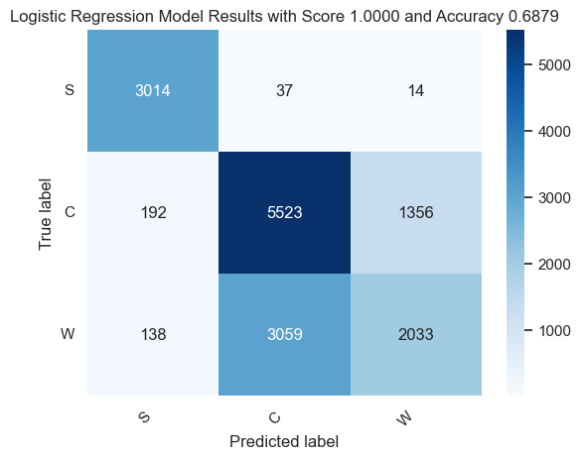
Forces in 3-space
Baseline Activity Detection
Following the same procedure as before, we tested a Logistic regression
Classifier model using angular velocity and acceleration. Adding filters did not
Significantly improve the results.
Model using both angular velocity and acceleration
Model using angular velocity, acceleration, and all filters

Slide 16
Forces in 3-space
Best Model for Activity Identification
To improve the results other models were tested
Multiple Classifier models were developed, including
Logistic Regression Support Vector Machine
Random Forest Decision Tree
K Nearest Neighbors Multi-layer Perceptron Classifier
The KNN model did quite
well, outperforming all
other models. All models
Were built on stratified
Train Test data, and compared
using a separate Validation
dataset.

Slide 17


Forces in 3-space
Reduction
The Feature Set was gradually reduced to identify a smaller set of features
with similar performance. Angular Velocity is the most predictive
Filtered Acceleration Only
Filtered Angular Velocity Only

Slide 18

Forces in 3-space
Reduction
Using KNN a good model can be built using only Instantaneous Angular Velocity
UnFiltered Angular Velocity Only

Slide 19
Forces in 3-space
Summary
We met the ask of identifying activity, and identifying individuals based on their gait.
Based on our findings, these explorations could be extended further
Identify Speed/Length of Stride
Abnormal locomotion
Handedness
In theory we can build a power tool that can identify its operator using gait biometrics, rather than a user id. This also suggests that a tool could be customized based on how a user is holding the tool (righty vs lefty etc)

